Slide 1
Victims’ Voices: Hearing the experiences of victims of sexual assault
Presentation to Australasian Evaluation Society 2011 International Conference
1 September 2011
Success Works Pty Ltd. ABN 20 0 274 430 Ph +61 3 9946 6800 97 Drummond Street, Carlton, VIC 3053 AUSTRALIA

Slide 2
Sharing our experience
Finding the best way to represent the experiences of those at the centre of the evaluation
The evaluation
Why we chose to make a DVD
How we went about it
What happened as a result
What we learnt
Success Works Pty Ltd. ABN 20 0 274 430 Ph +61 3 9946 6800 97 Drummond Street, Carlton, VIC 3053 AUSTRALIA

Slide 3
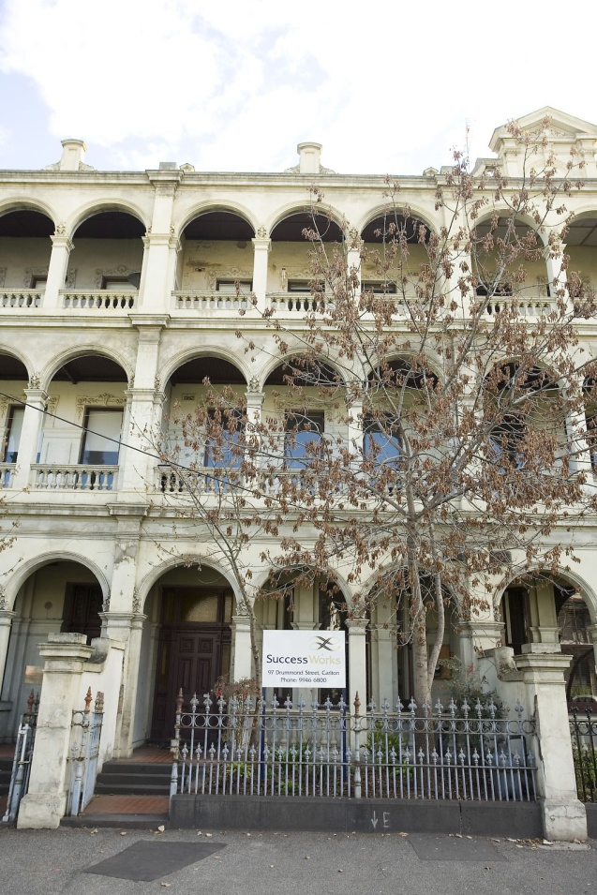
Our company
Success Works nurtures systemic improvement in social justice and human rights.
We work across a wide range of social policy areas, especially in areas of deep complexity.
We are a values-based company, applying a systems and strengths approach with participatory engagement.
Success Works Pty Ltd. ABN 20 0 274 430 Ph +61 3 9946 6800 97 Drummond Street, Carlton, VIC 3053 AUSTRALIA

Slide 4
Victorian Sexual Assault Reform Strategy
Three year evaluation:
16 initiatives across seven agencies
legislative reform
cultural change and improved approaches to victim/survivors.
We used:
mixed methods approach
strong formative component
interviews with over 80 victim/survivors.
Reporting to:
high level Advisory Committee of judicial officers, legal practitioners, police, and senior government officials.
Success Works Pty Ltd. ABN 20 0 274 430 Ph +61 3 9946 6800 97 Drummond Street, Carlton, VIC 3053 AUSTRALIA

Slide 5
So much rich data
Narrative approach in interviewing victim/survivors
Transcribing interviews
Analysing data
But
How could we convey their experience and influence the cultural change agenda of the reforms
Success Works Pty Ltd. ABN 20 0 274 430 Ph +61 3 9946 6800 97 Drummond Street, Carlton, VIC 3053 AUSTRALIA

Slide 6
Let’s make a DVD
Ethical considerations
Privacy of the victim/survivors
Maintaining integrity of the experience
Deciding what sort of DVD to make
Getting the client on side
Success Works Pty Ltd. ABN 20 0 274 430 Ph +61 3 9946 6800 97 Drummond Street, Carlton, VIC 3053 AUSTRALIA

Slide 7
The practicalities of DVD making
Writers
Film makers
Actors
Success Works Pty Ltd. ABN 20 0 274 430 Ph +61 3 9946 6800 97 Drummond Street, Carlton, VIC 3053 AUSTRALIA

Slide 8
The practicalities of DVD making
Writers
Film makers
Actors
Success Works Pty Ltd. ABN 20 0 274 430 Ph +61 3 9946 6800 97 Drummond Street, Carlton, VIC 3053 AUSTRALIA

Slide 9
Influencing hearts and minds
Special screening for
Advisory Committee
The silence
“That doesn’t happen in my court..”
“We need to make sure that doesn’t happen any more..........”
“We are making change................”
Success Works Pty Ltd. ABN 20 0 274 430 Ph +61 3 9946 6800 97 Drummond Street, Carlton, VIC 3053 AUSTRALIA

Slide 10
Did it have an impact?
Renewed energy for the
reforms
Ability to see and hear
system wide impact
Police training package
Staff training for policy officers
Success Works Pty Ltd. ABN 20 0 274 430 Ph +61 3 9946 6800 97 Drummond Street, Carlton, VIC 3053 AUSTRALIA

Slide 11
What did we learn?
Partnership and trust are key
Can really focus on the people at the centre
Impact and understanding of other parts of the system
It’s a powerful medium
Success Works Pty Ltd. ABN 20 0 274 430 Ph +61 3 9946 6800 97 Drummond Street, Carlton, VIC 3053 AUSTRALIA

Slide 12
Acknowledgements
Thank you to:
Victim/Survivors for
sharing their experiences
Department of Justice for
permission to show excerpts
from Victims’ Voices.
Note DVD is not publically available
Success Works Pty Ltd. ABN 20 0 274 430 Ph +61 3 9946 6800 97 Drummond Street, Carlton, VIC 3053 AUSTRALIA

